Slide 1
HIFK Playoff Profit Calculator
Scenario-based Profitability Modeling for Playoff Home Games

Slide 2
Executive Summary
Playoff profitability is highly uncertain, attendance and pricing drive revenue
Playoff games represent a high-risk, high-reward revenue stream
I Build scenario-based profitability model for playoff home games
Model explains how to price tickets and concessions for maximum profit

Slide 3
Business Context
Uncertain number of home games
Pricing is critical
Revenue is highly attendance-sensitive → Financial exposure increases before upside is secured
Financial profits can be massive, depending on the length of run and cost structure

Slide 4
Core Business Question
Primary question
When does a playoff run become financially profitable?
Supporting questions
Which variables drive outcomes most materially?
At which stage is financial risk highest relative to reward?

Slide 5
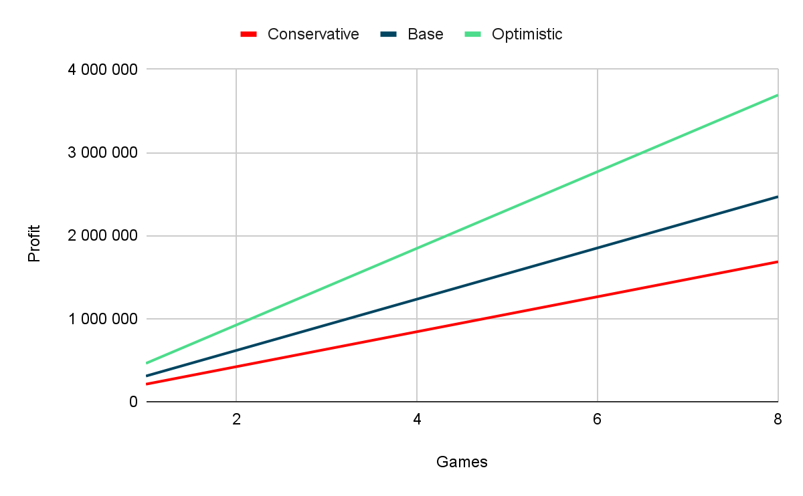
Model Overview
A scenario-based model translates uncertain playoff paths into financial outcomes

Slide 6
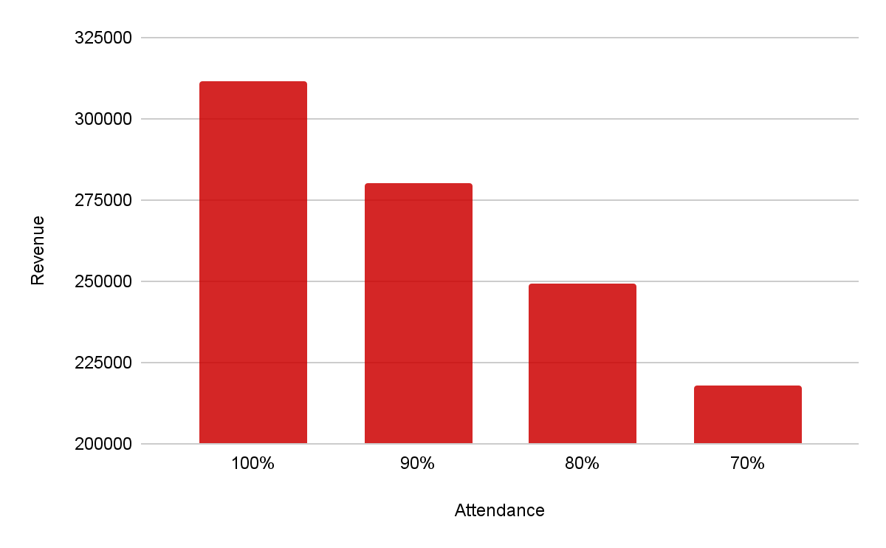
Attendance Drives Revenue
1.
Attendance impacts profitability through increased revenue more than marginal cost control.
Small changes in attendance have outsized impact
Implication: prioritize pricing, marketing, and fan engagement over micro-cost optimization
2.
3.
with avg ticket price of 38€

Slide 7
Decision Impact
The model enables proactive financial decision-making before and during playoffs
Budget planning under uncertainty
Risk communication to executives and boards
Real-time decision support during playoffs

Slide 8
Transferability & Scalability
This approach is applicable beyond a single team to other leagues and event-driven businesses
Other Liiga teams
Other sports leagues
Any event-driven business with uncertain volume

Slide 9
Next Steps
Integrating historical data and probabilities would significantly increase decision value
Integrate historical playoff data
Add probability-weighted scenarios
Deploy as an interactive dashboard

